Slide 1
Final Paper
What to do and how to do it.

Slide 2
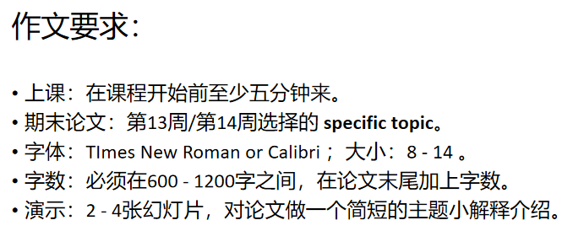

Slide 3
Sessions
The final paper will be divided up into sessions, please only come to class AT LEAST FIVE MINS BEFORE YOUR SESSION BEGINS.
If you are late, your group might begin without you and you will have to return on another day.
Sessions will contain a time to copy over any files to present and then time for all the group members to hand in their portfolios and finally, give a quick presentation on what exactly their paper are about.
You will not be able to change your time, you only need to be in the class for thirty minutes, please make sure that you make the necessary arrangements before next week.
Any requests for changes or excuses will be totally ignored by me.

Slide 4
Please take a note of the schedule
Session No | Groups | Time
1 - 10:00 | A13 Groups 1 - 5 | 10:00 - 10:30
2 - 10:30 | A13 Groups 6 - 10 | 10:30 - 11:00
3 - 11:00 | A13 Groups 11 - 14 | 11:00 - 11:30
4 - 11:30 | A14 Groups 1 - 5 | 11:30 - 12:00
5 - 12:00 | A14 Groups 6 - 10 | 12:00 - 12:30
6 - 14:30 | A14 Groups 11 - 14 | 14:30 - 15:00
7 - 15:00 | A15 Groups 1 - 5 | 15:00 - 15:30
8 - 15:30 | A15 Groups 6 - 10 | 15:30 - 16:00
9 - 16:00 | A15 Groups 11 - 13 | 16:00 - 16:30
10 - 16:30 | A16 Groups 1 - 5 | 16:30 - 17:00
11 - 17:00 | A16 Groups 6 - 12 | 17:00 - 17:30

Slide 5
Portfolio
You will also hand in your portfolio during the presentation class in week 15 of the Fall semester.
Please ensure that not only is all your homework in the portfolio, but that you have also put your name and student number on EVERY SINGLE PIECE OF PAPER THAT IS IN YOUR PORTFOLIO.
The Thesis Generator print-out should be included in your portfolio as well.
Group assignments will be checked and the same grade given to all names written on the group assignments. If your name is written on more than one group assignment, you will be given the lower score.
Ensure that your portfolio closes tightly and won't open or spill out during transport and transition periods where the portfolios are given to other members of staff to check and verify.

Slide 6
Final Paper - EACH PERSON WRITES A PAPER BY THEMSELVES
Your final paper MUST MATCH the specific topic that you chose during week 13/week 14.
If there is no match between your specific topic and your written topic, you will get a grade deduction of 20%.
Your specific topic should not be changed in any way.
Please TYPE OUT your paper in TImes New Roman or Calibri font - any size between 8 - 14 will be okay but nothing smaller than 8 and nothing bigger than 14 will be allowed.
Your final paper must follow course outlines for essay writing and must be between 600 - 1200 words long. Nothing less and nothing more will be allowed.
Please include a word count at the end of your paper.

Slide 7
Final Presentation
With your final paper, you will also give a very brief presentation of your paper.
The presentation should be about 2 - 4 slides long.
It will be a concise introduction to your group broad topic as well as a small explanation on how exactly you decided to tackle the topic that your chose.
Please ensure that the entire group only uses one, single PPT as there will not be enough time for each individual to copy and open a PPT presentation before they begin.
Do not worry about speaking for a short time but do pay attention to not go over time and speak for too long (or I will have to stop you while you are presenting)

Slide 8
Final Notes
Pay close attention to your paper's small details: things like forgetting to write names or handwriting a paper can often land a student in the dogbox when it comes to the end of the semester.
Any course queries should be forwarded to my QQ contact and should be done BEFORE week 16.
I will not be able to handle any grade queries after week 16 as I will be able to access the student grade system after week 16.
If you have missed the test in week 13 or week 14, please contact me so that we can arrange some time for you to try and write the test. I cannot, however, guarantee that we will be able to make time for you to rewrite the test.

